Slide 1




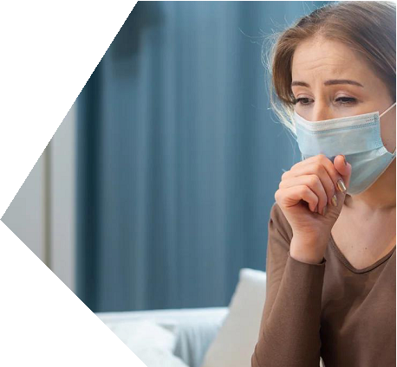




1
ISOLATE
THE SICK PERSON
✶ Prepare a separate room or isolat
space, and keep distance from ot rs.
✶ Keep the room well ventilated and open windows frequently.
WHAT TO DO IF
SOMEONE IS SICK WITH
COVID AROUND YOU
2
REDUCE CONTACT
WITH THE VIRUS
3
TAKE CARE
OF THE SICK PERSON
✶
✶
✶
✶
Identify one household member to be
the contact person who is not at high risk and has
the fewest contacts with people outside.
Wear a medical mask if in the same room as the
sick person.
Use separate dishes, cups, eating utensils and
bedding from the sick person.
Clean and disinfect frequently touched surfaces.
❖
Monitor the sick person's
symptoms regularly.
Pay special attention if
the person is at high risk
for serious illness.
Ensure the sick person
rests and stays hydrated.
❖
❖
Call for Emergency
123-456-7890

