Slide 1
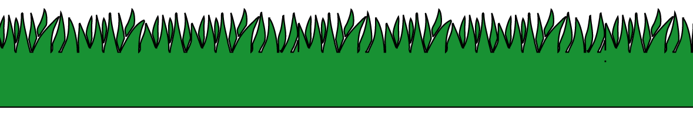
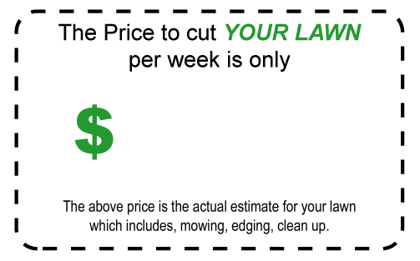
CHARLIE’S
YARD WORK & DECK STAINING
Save time and
money on:
•
•
•
Lawn Mowing
Mulching
Trimming
• Weeding
• Deck Staining
• Fall Cleanups
More!
And
Much
2004 Gopher Software

