Slide 1
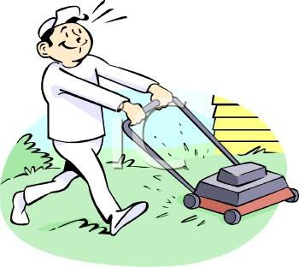
Lawn
Mowing

