Slide 1
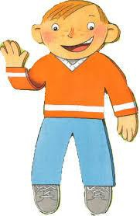
Flat Stanley Letter
Dear Families,
My students and I are reading Flat Stanley. This is a wonderful story about a boy who, after
being flattened by a bulletin board, is mailed off and has numerous traveling adventures.
In the near future, our class will send flat versions of ourselves to a friend or relative of your
child’s choice. Ideally, the recipient should live out of your country area. We will be plotting all of
our flat kids’ adventures, so the further away the better. However, we do need the flat kids to
stay within the continental United States so we can be assured that they will return to us by the
end of the school year.
When choosing whom to send your flat self to, please have your child consider who will be
willing to reply about the adventures of your child’s flat kid. (The project will not be complete
unless we have all the replies.)
Please complete the form below and return it to the school not later than . Please feel free to contract me if you have any questions about this project.
at number and email.
Thanks You,
Student’s Name:
Name and address of a friend to flat mail letter

