Slide 1


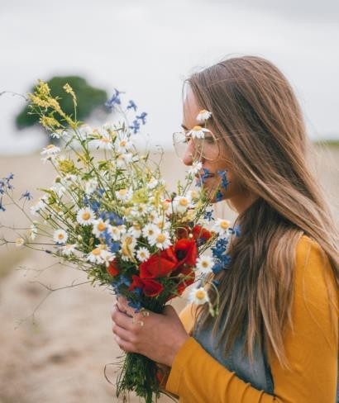

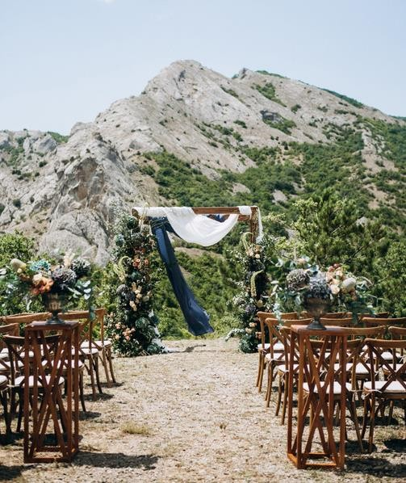
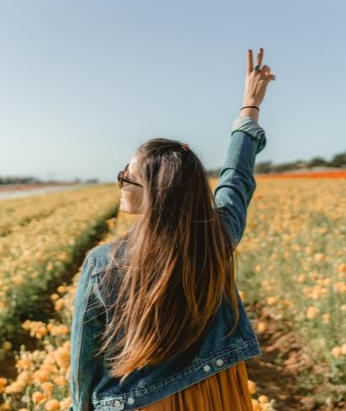










P R I C E L I S T
Package One
1 hour season
25 edited pictures One location Photo album One 5x7 print Online access
$275
Package two
2 hour seasons
50 edited pictures Two locations Photo album Three 5x7 prints Online access
$450
Package three
8 hour seasons
250 edited pictures Two locations Photo album Canvas prints Online access
$750
C A N V A S P R I N T S A L B U M S
5x7 $35 4x6 $12 10x10 $275
8x10 $74 5x7 $24 12x12 $300
8x20 $125 6x8 $45 14x11 $450
20x30 $250 6x10 $50
30x50 $375 11x14 $57
13x19 $64

